Slide 1
Trekking Route Planning for Nepali Mountain Trails
based on Time, Distance and Difficulty
Team Greedy Whales
Rohit Kumar Sah and Dipesh Duwal
CS456 - Analysis of Algorithms
Spring 2025

Slide 2
Big Problem
Trekking in Nepal involves navigating diverse terrains with varying elevation and difficulty.
Traditional route planning is experience-based and lacks optimization.
Need for a data-driven system.
Objective: maximize key location visits while staying within time and difficulty constraints.

Slide 3
Methodology
01
02
Goal
Algorithms Chosen:
Optimize route for difficulty, time, and importance
Ensure feasibility under diverse trekking scenarios
Evaluate algorithm scalability, adaptability, and real-world effectiveness
Greedy Best-First Search (GBFS)
Divide & Conquer Trail Selection
Dynamic Programming with memoized recursion

Slide 4
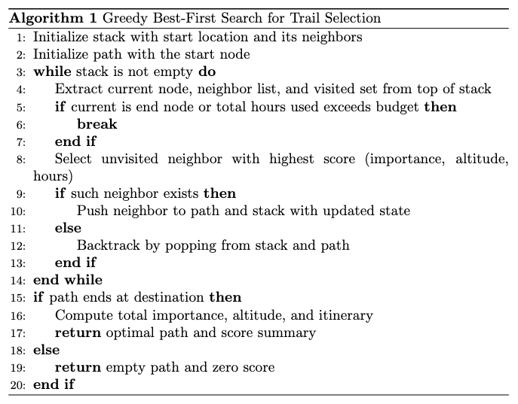
Algorithm 1 – Greedy BFS
Iteratively selects the next best unvisited neighbor based on a heuristic score.
Prioritizes importance, while penalizing altitude gain and travel time.
Uses a stack-based approach to explore one path deeply until blocked.
Fast and simple, but not guaranteed to find the optimal path.
Time Complexity: O(n⋅d), where d is the average number of neighbors.
Space Complexity: O(n) for the stack, visited set, and path.
Greedy Heuristic Score Equation:

Slide 5
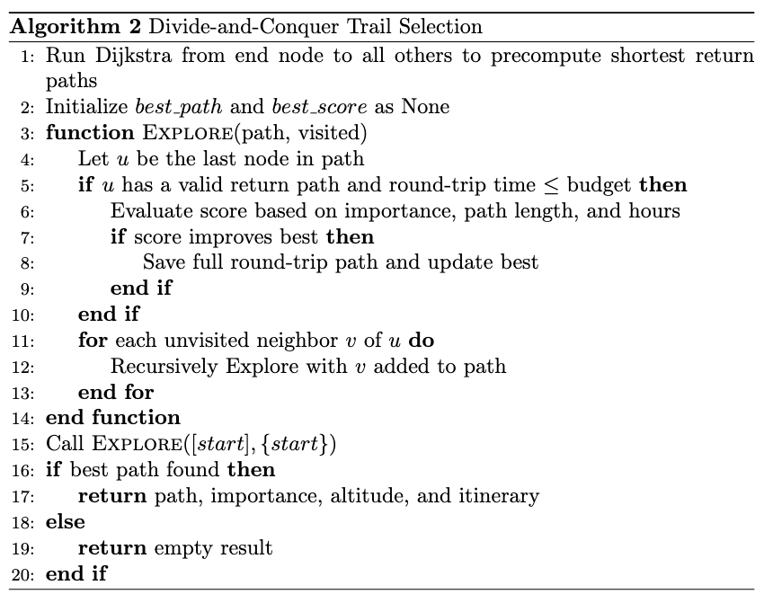
Algorithm 2 - Divide and Conquer Trail Selection
Recursively explores all outbound trail paths from the start node.
Selects the path that maximizes importance, exploration depth, and fits within the time budget.
Represents a divide-and-conquer approach by splitting the trail problem into: Outbound exploration (subproblem 1) and Return optimization (subproblem 2)
Guarantees optimality but at the cost of high computation
Time Complexity: O(n²)+O(ElogV) Why: It recursively explores all simple outbound paths and uses Dijkstra once for return paths.
Space Complexity: O(n+E) Why: It stores the path, visited nodes, and Dijkstra’s return tables.

Slide 6
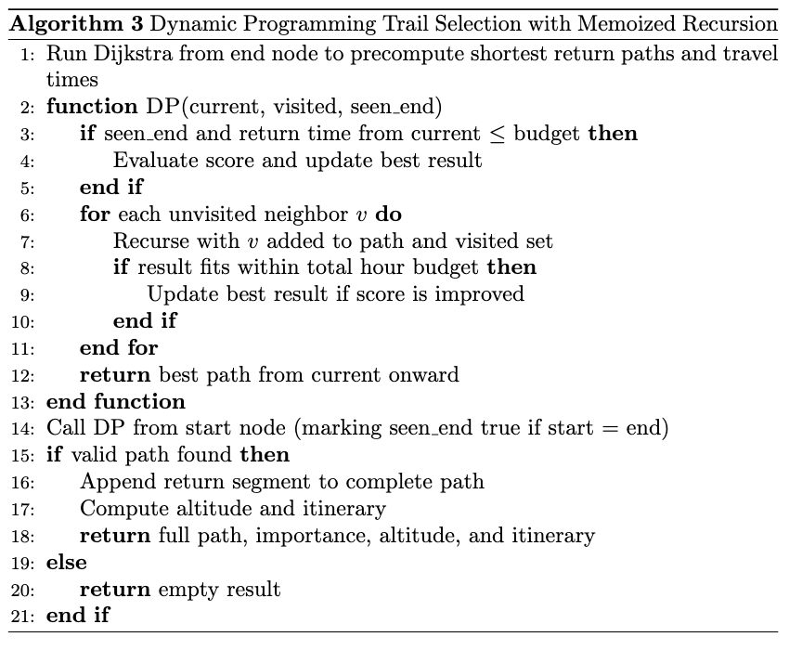
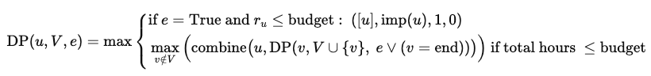
Algorithm 3 – Dynamic Programming
Recursively explores all paths with memoization to avoid recomputation.
Stores best scores for each node and visited set combination.
Guarantees optimal path under time and visit constraints.
Uses DP by solving and caching overlapping subproblems.
More accurate but slower than greedy methods.
Time Complexity: O(n²)+O(ElogV)
Space Complexity: O(n+E)
As it explores all subsets of nodes via recursion and memoizes each unique (node, visited set) combination.
Recursive State Transition Formula:

Slide 7
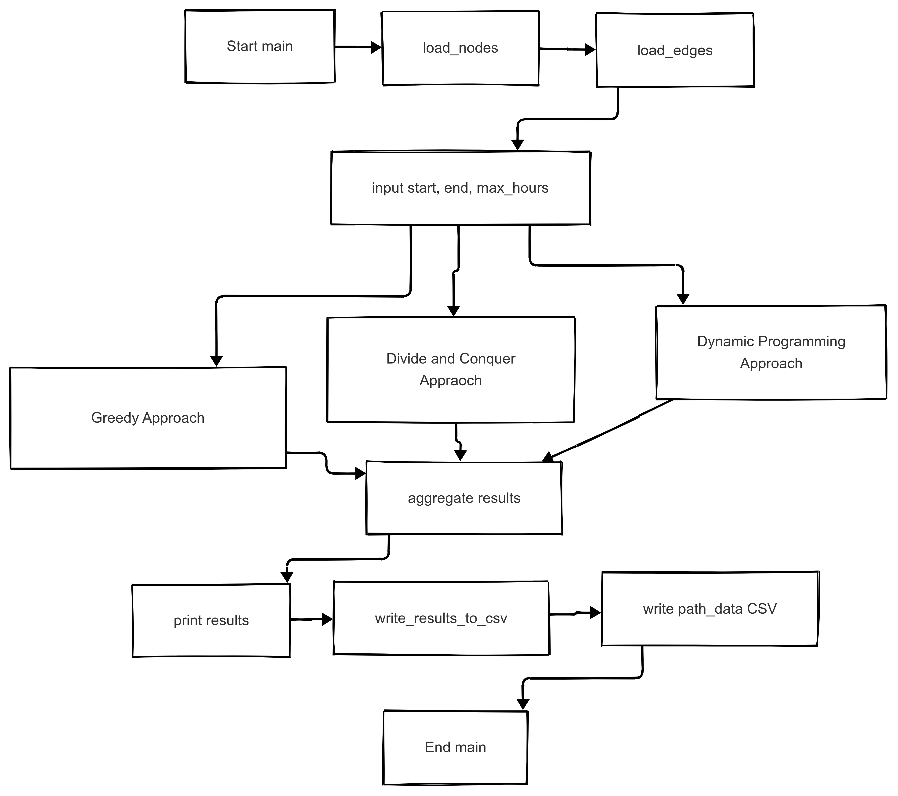
Block Diagram

Slide 8
Experiments
Scalability
Adaptability
Real World Performance
Runtime and Storage Consumption on increasing network size as parameters. (10,20,50,75,100)
Runtime and Storage Consumption on increasing input paramters (days) on the test dataset.
Comparision of similarities betwen Path taken by Trekkers across the years and algorithm suggested path.

Slide 9
Dataset
For each coordinate, altitude data from OEM
Raw Trail Coordinates from NATA of Gaurishanker Conservation Area
Open Elevation Map Data For Altitude Data
GEO JSON Data
02
04
01
Open Street Map Data For Co-ordinates
03
Processed Nodes and Edges
Converted into Nodes and Edges for easier processing
For each coordinate, location name and importance data from OSM

Slide 10

Dataset
113
116
Nodes
Edges
name, latitude, longitude, altitude, importance
source, target, distance, altitude_diff
Altitude
Importance
Mean ≈ 2,300 m
Range 942 m → 3,434 m
Most values ~ 0.053 Low variance

Slide 11
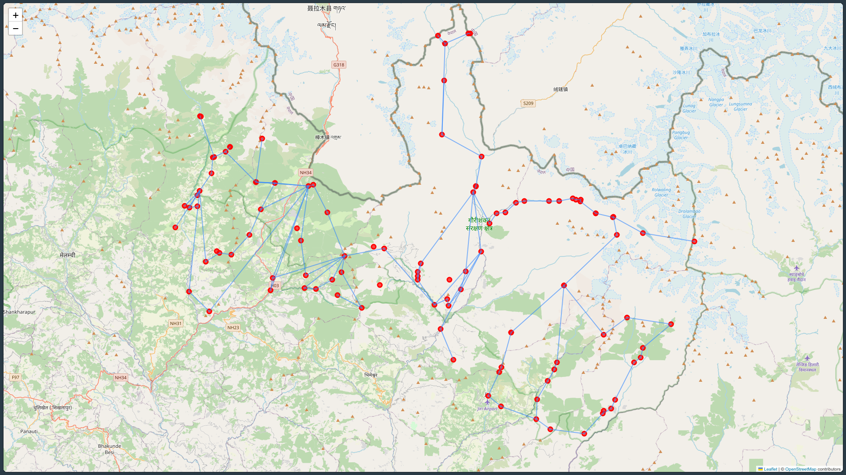
Showing all the nodes and edges (processed)

Slide 12
Results!
Now let's have a look at some graphs, eh?

Slide 13
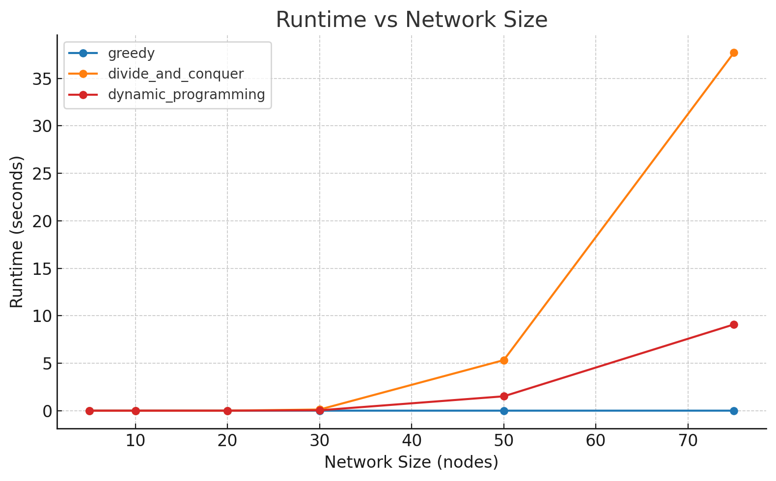
E1: Scalability Results

Slide 14
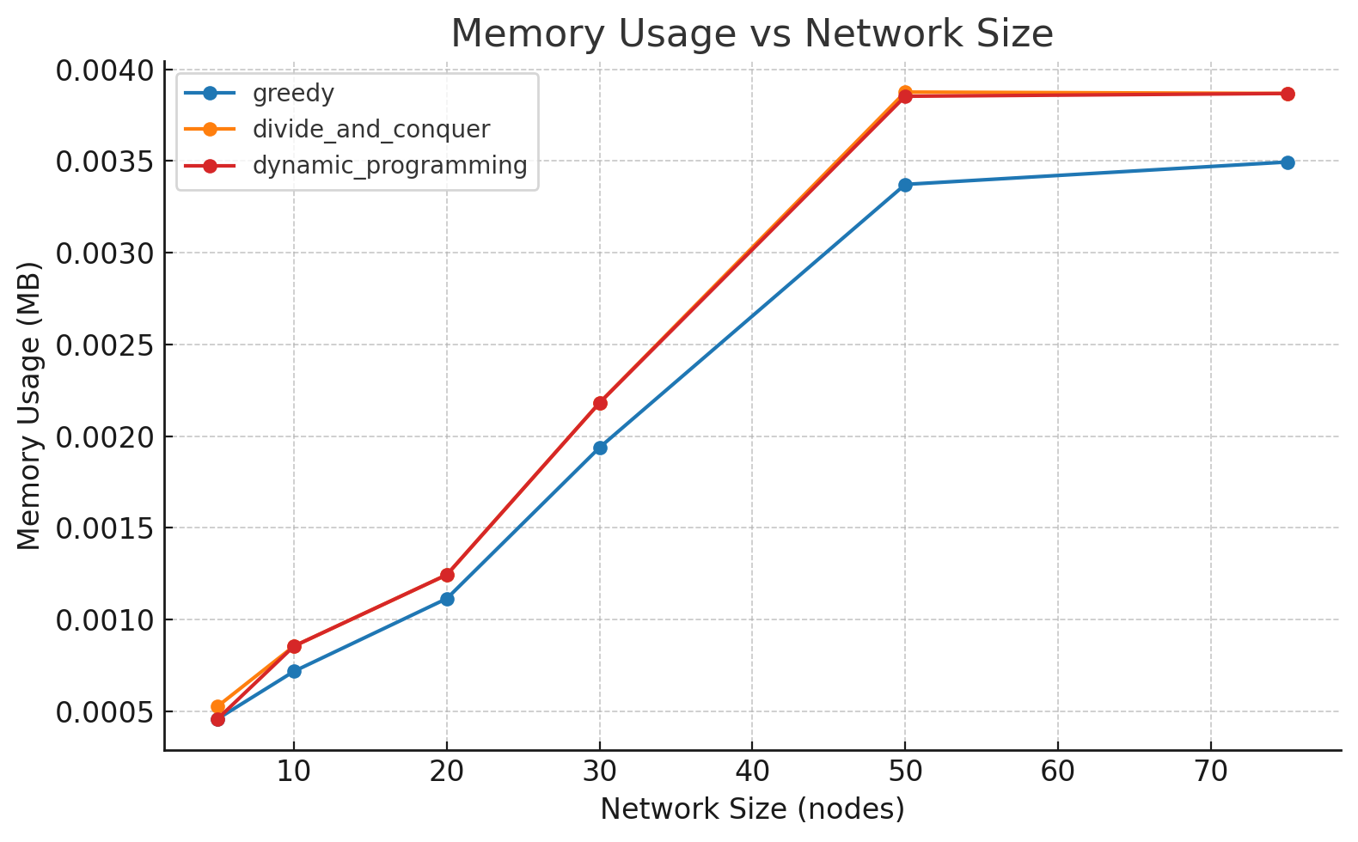
E1: Scalability Results

Slide 15
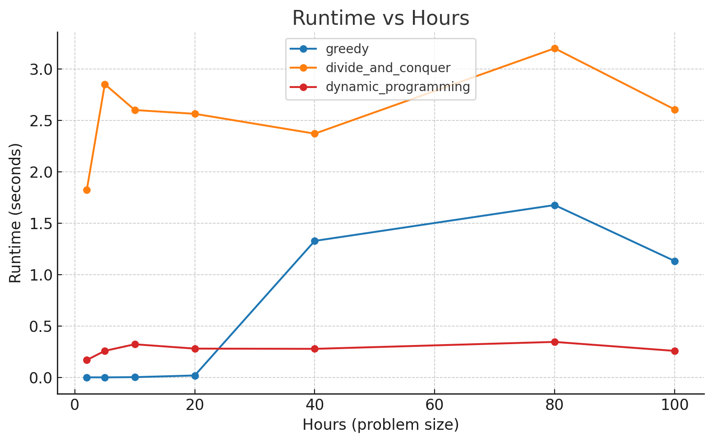
E2: Adaptability Results

Slide 16
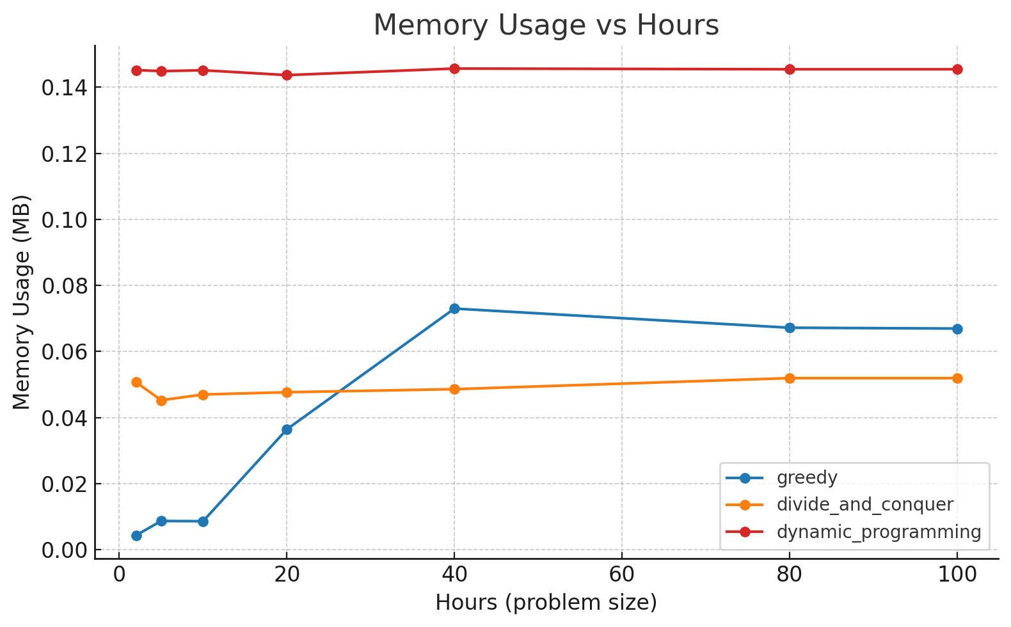
E2: Adaptability Results

Slide 17
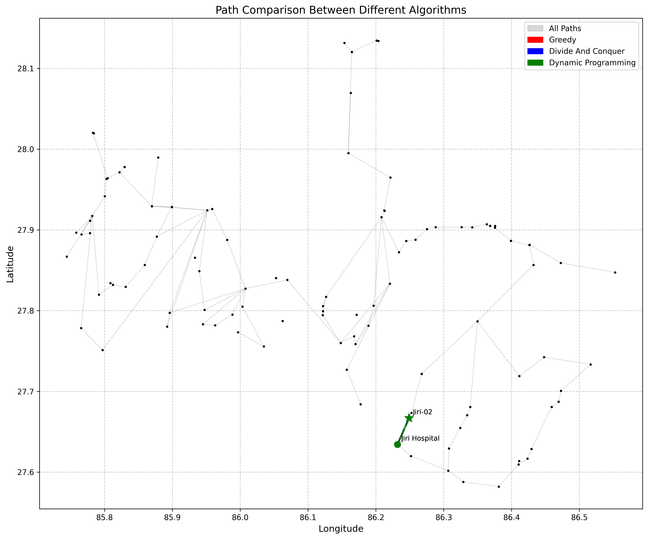
E2: Adaptability Results (2 hours)

Slide 18
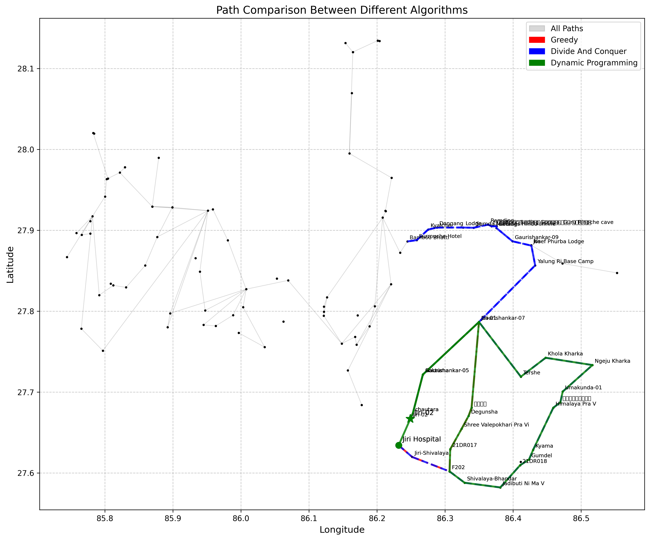
E2: Adaptability Results (30 hours)

Slide 19
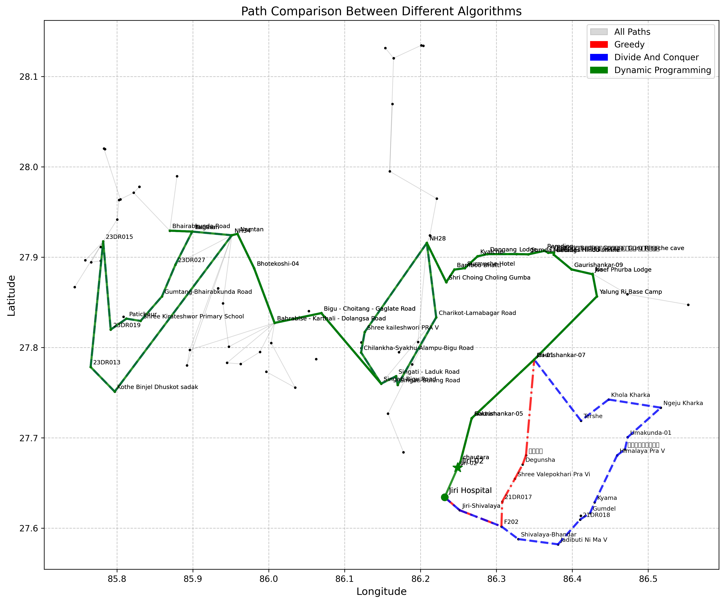
E2: Adaptability Results (100 hours)

Slide 20
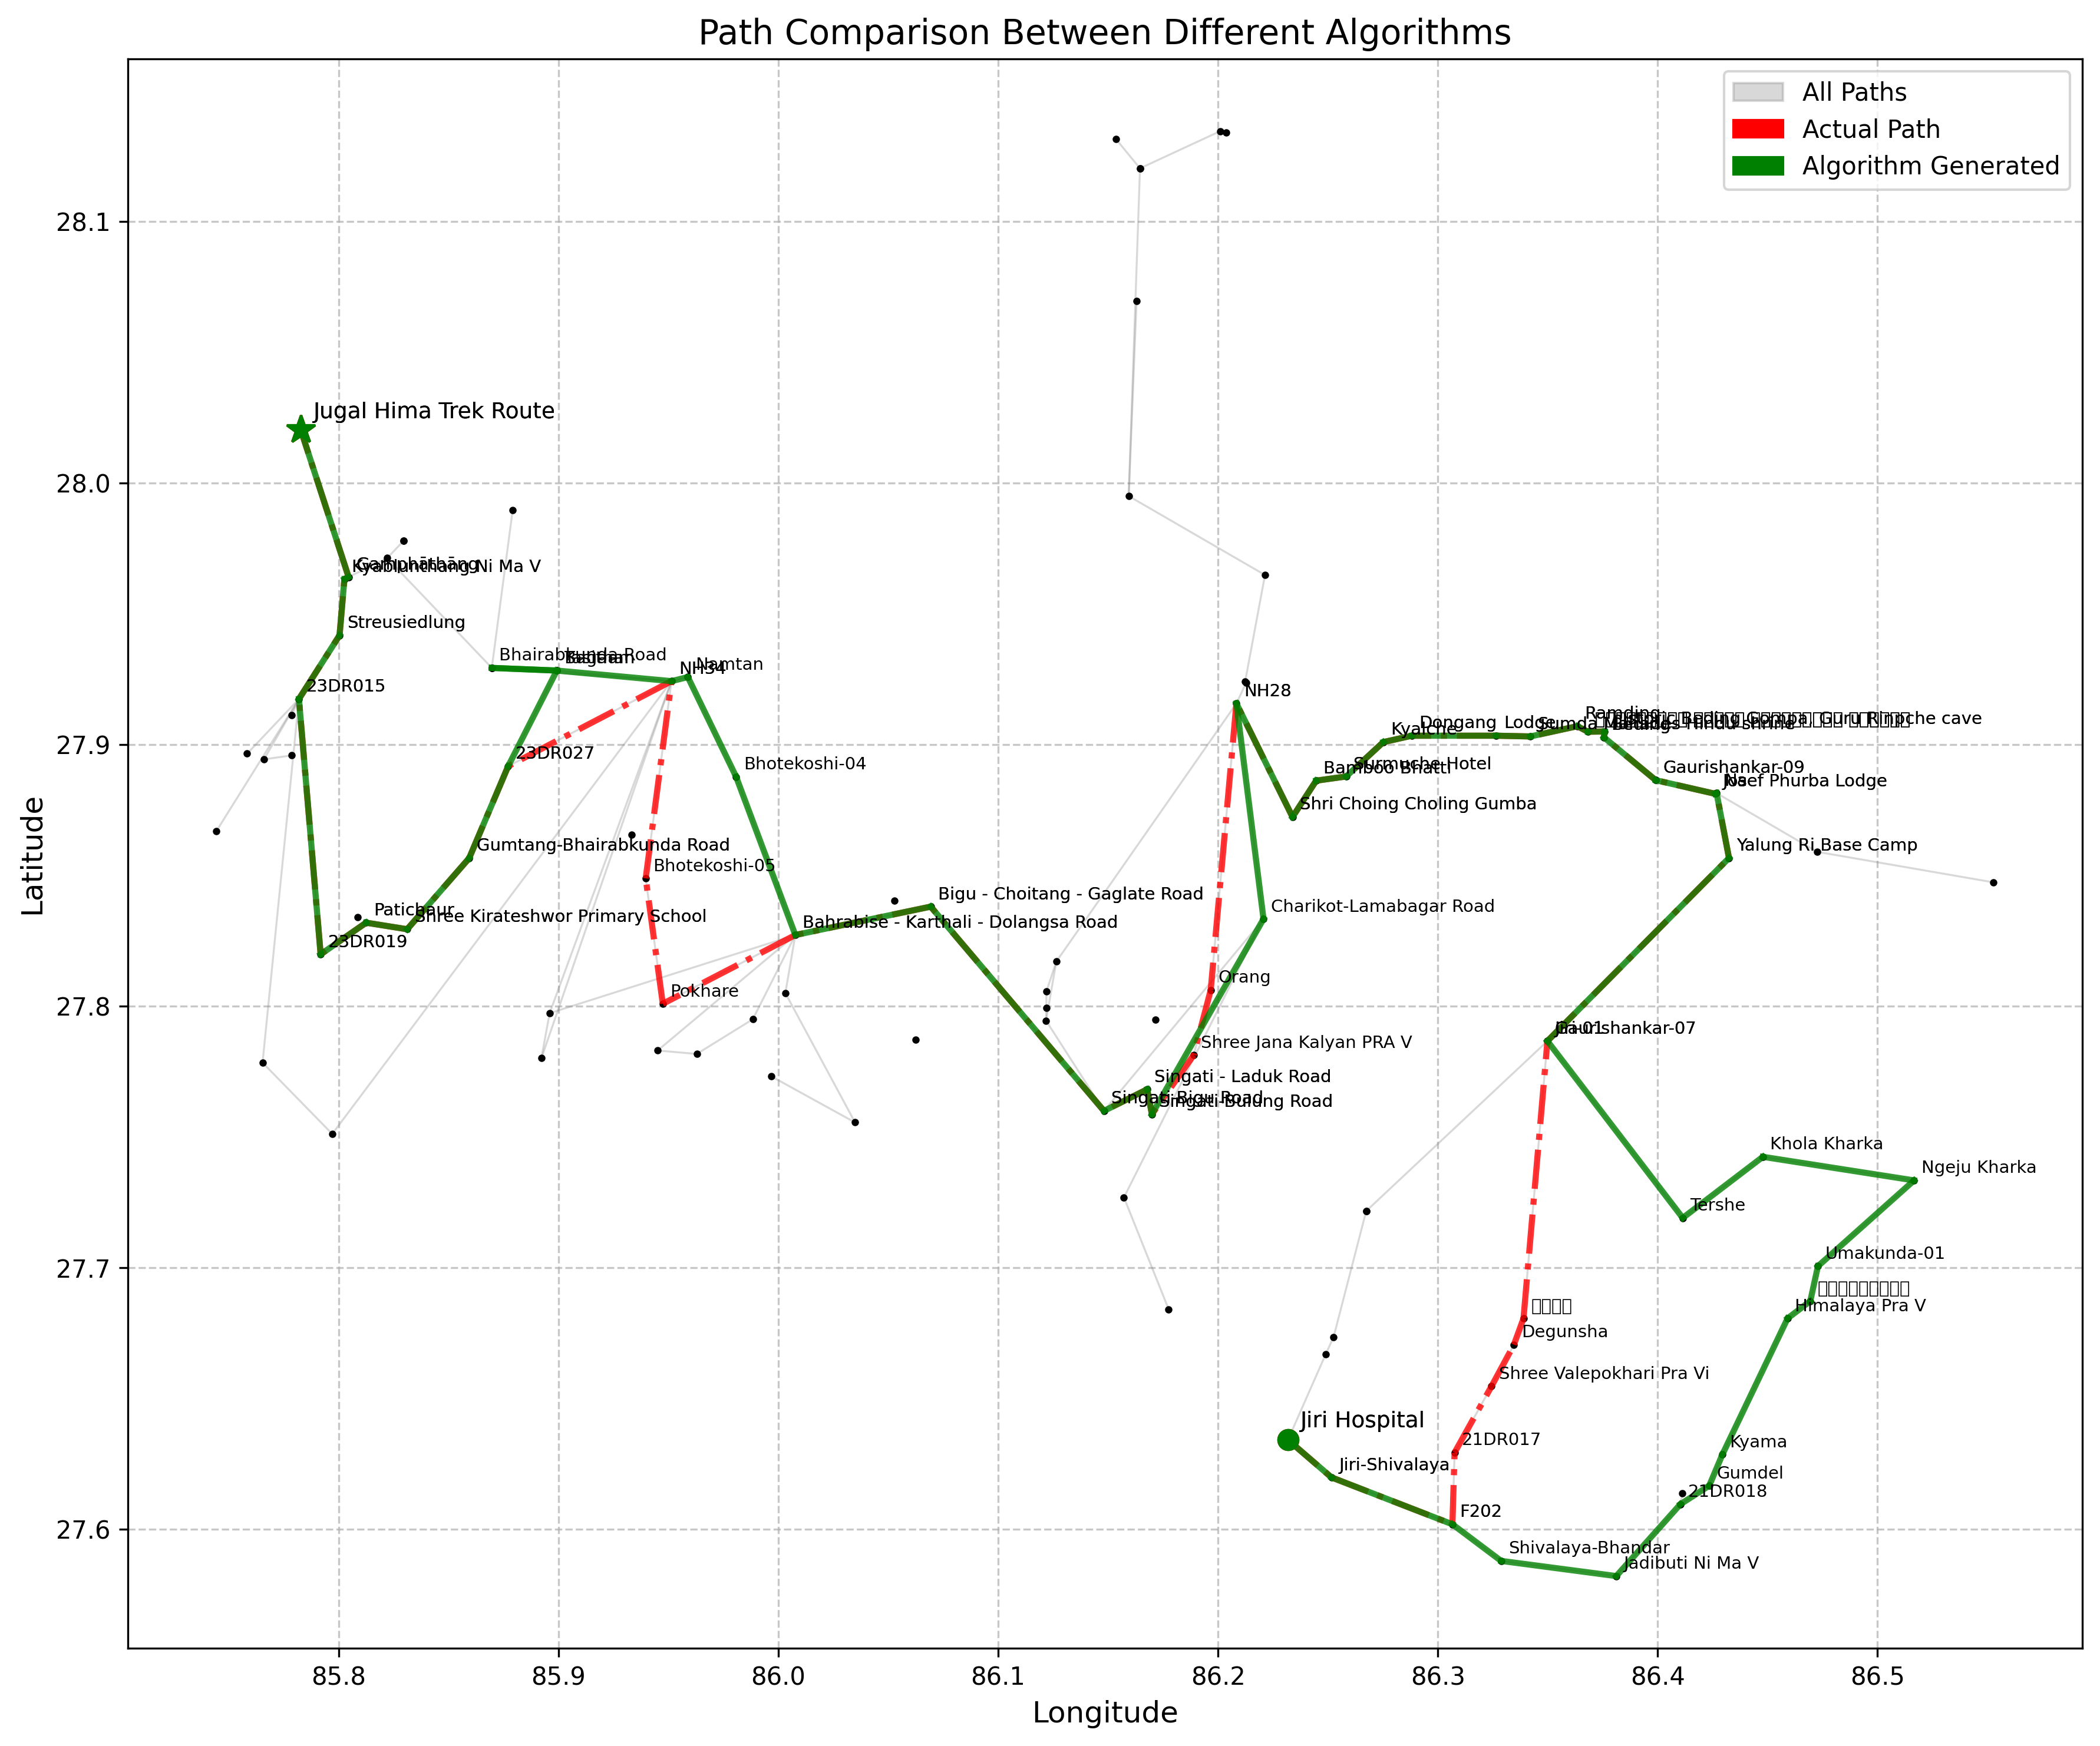
E3: Real World Performance
~60-70% Path matches to traditional path
Actual Path is selected based on the itinerary shown in trekkersnepal.com

Slide 21
Conclusion
Greedy
Divide and Conquer
Dynamic Programming
Greedy is by far the most scalable in both time and space.
(but wont consider hours contraints)
Divide & Conquer suffers from explosive runtime growth despite moderate memory use.
Dynamic Programming strikes a middle ground between results accuracy and runtime.

Slide 22
Future Works
Active Trekking Route Data Collections.
Adding hyper paramters like walking speed, hours in a day and other trekking paramters to personalize results.
Visual Overlay on actual Google Maps data to show more realastic charts.
Heuristics Tuning and Memory Optimization for Dynamic Programming Appraoch.

Slide 23
Thank you
Any questions?
Team Greedy Whales
Rohit Kumar Sah & Dipesh Duwal

